Slide 1


HOW TO IN Yaml

Slide 2

Install vscode

Slide 3

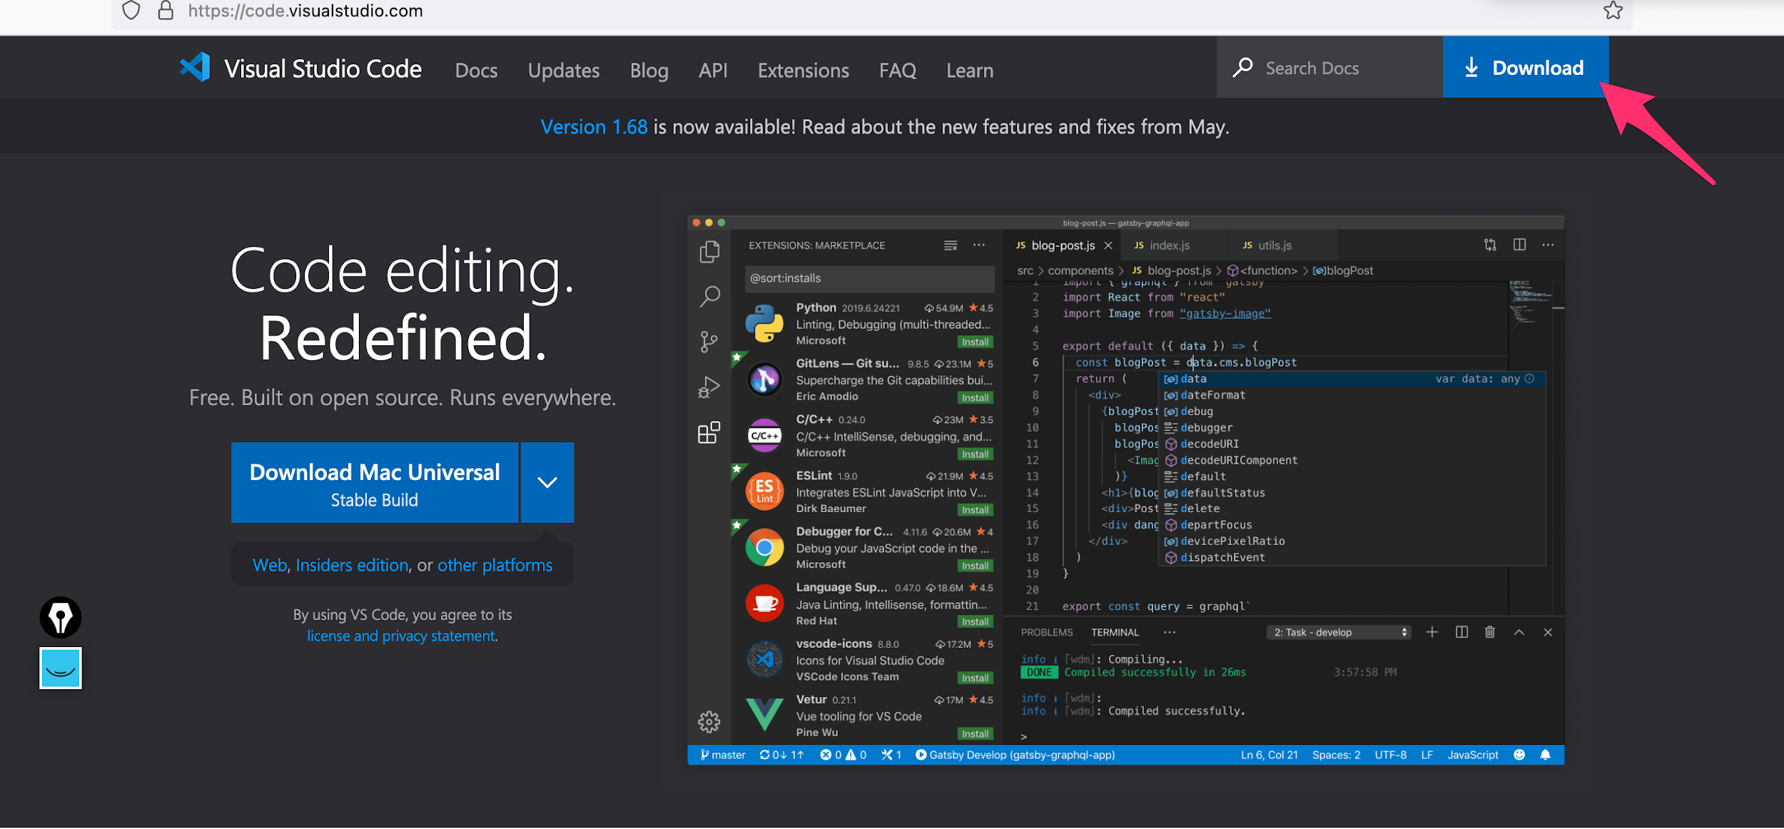
Install vscode
open the following link https://code.visualstudio.com/ and download vscode.
2- install vscode (the package to download is available on your download directory)

Slide 4
Use the online version of vscode
1- open the following url
https://vscode.dev/

Slide 5
Bingo, you now have vscode

Slide 6
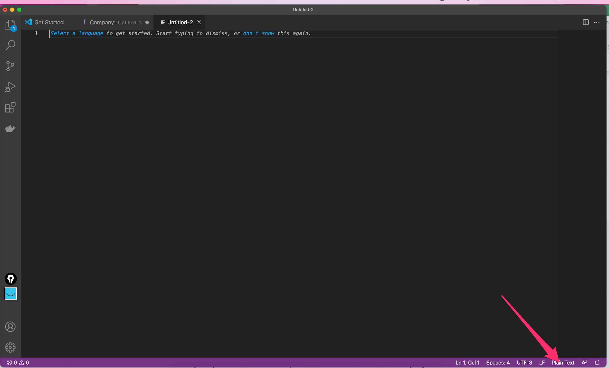
Set vscode to yaml
Click where the arrow is pointing another window will open

Slide 7
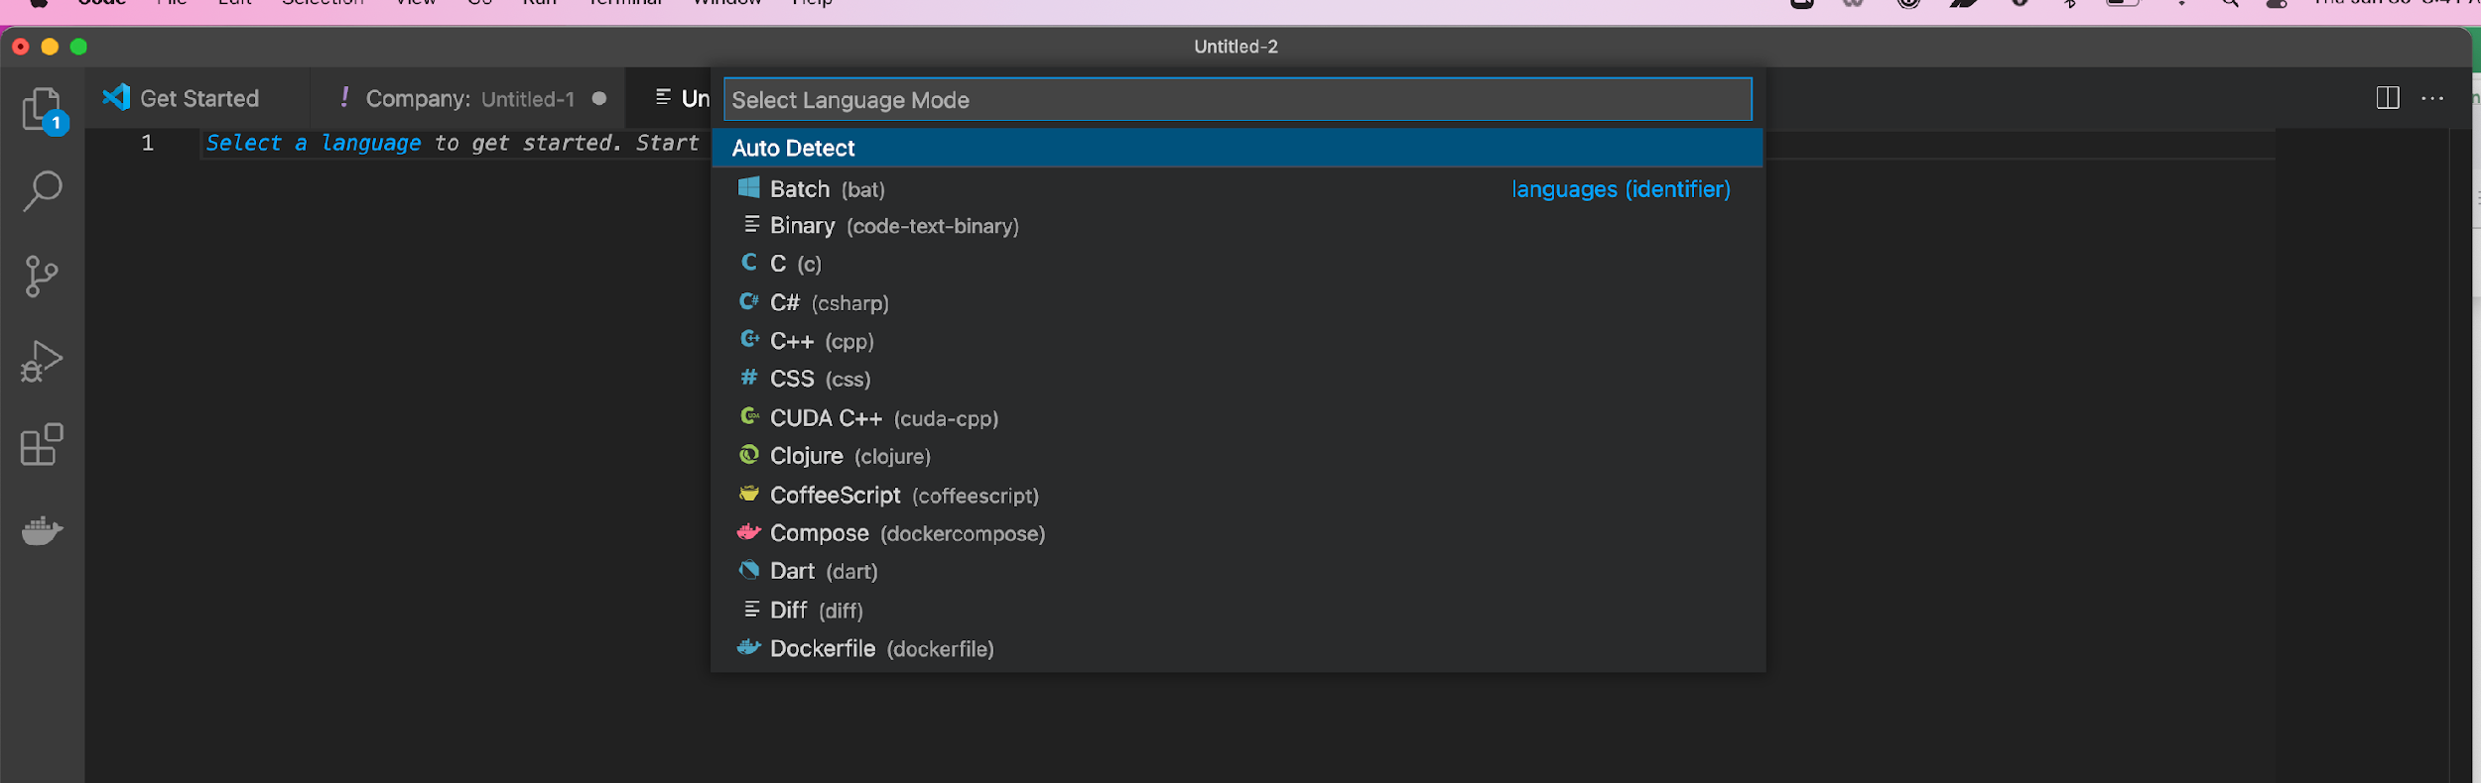
Set vscode to yaml
Enter the language you would like vscode to be set

Slide 8
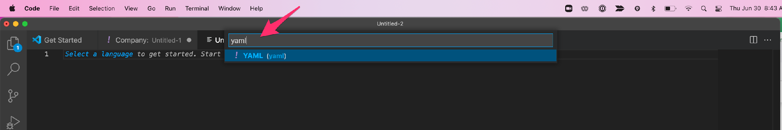
Set vscode to yaml
Enter the language you would like vscode to be set and select it when it appear

Slide 9
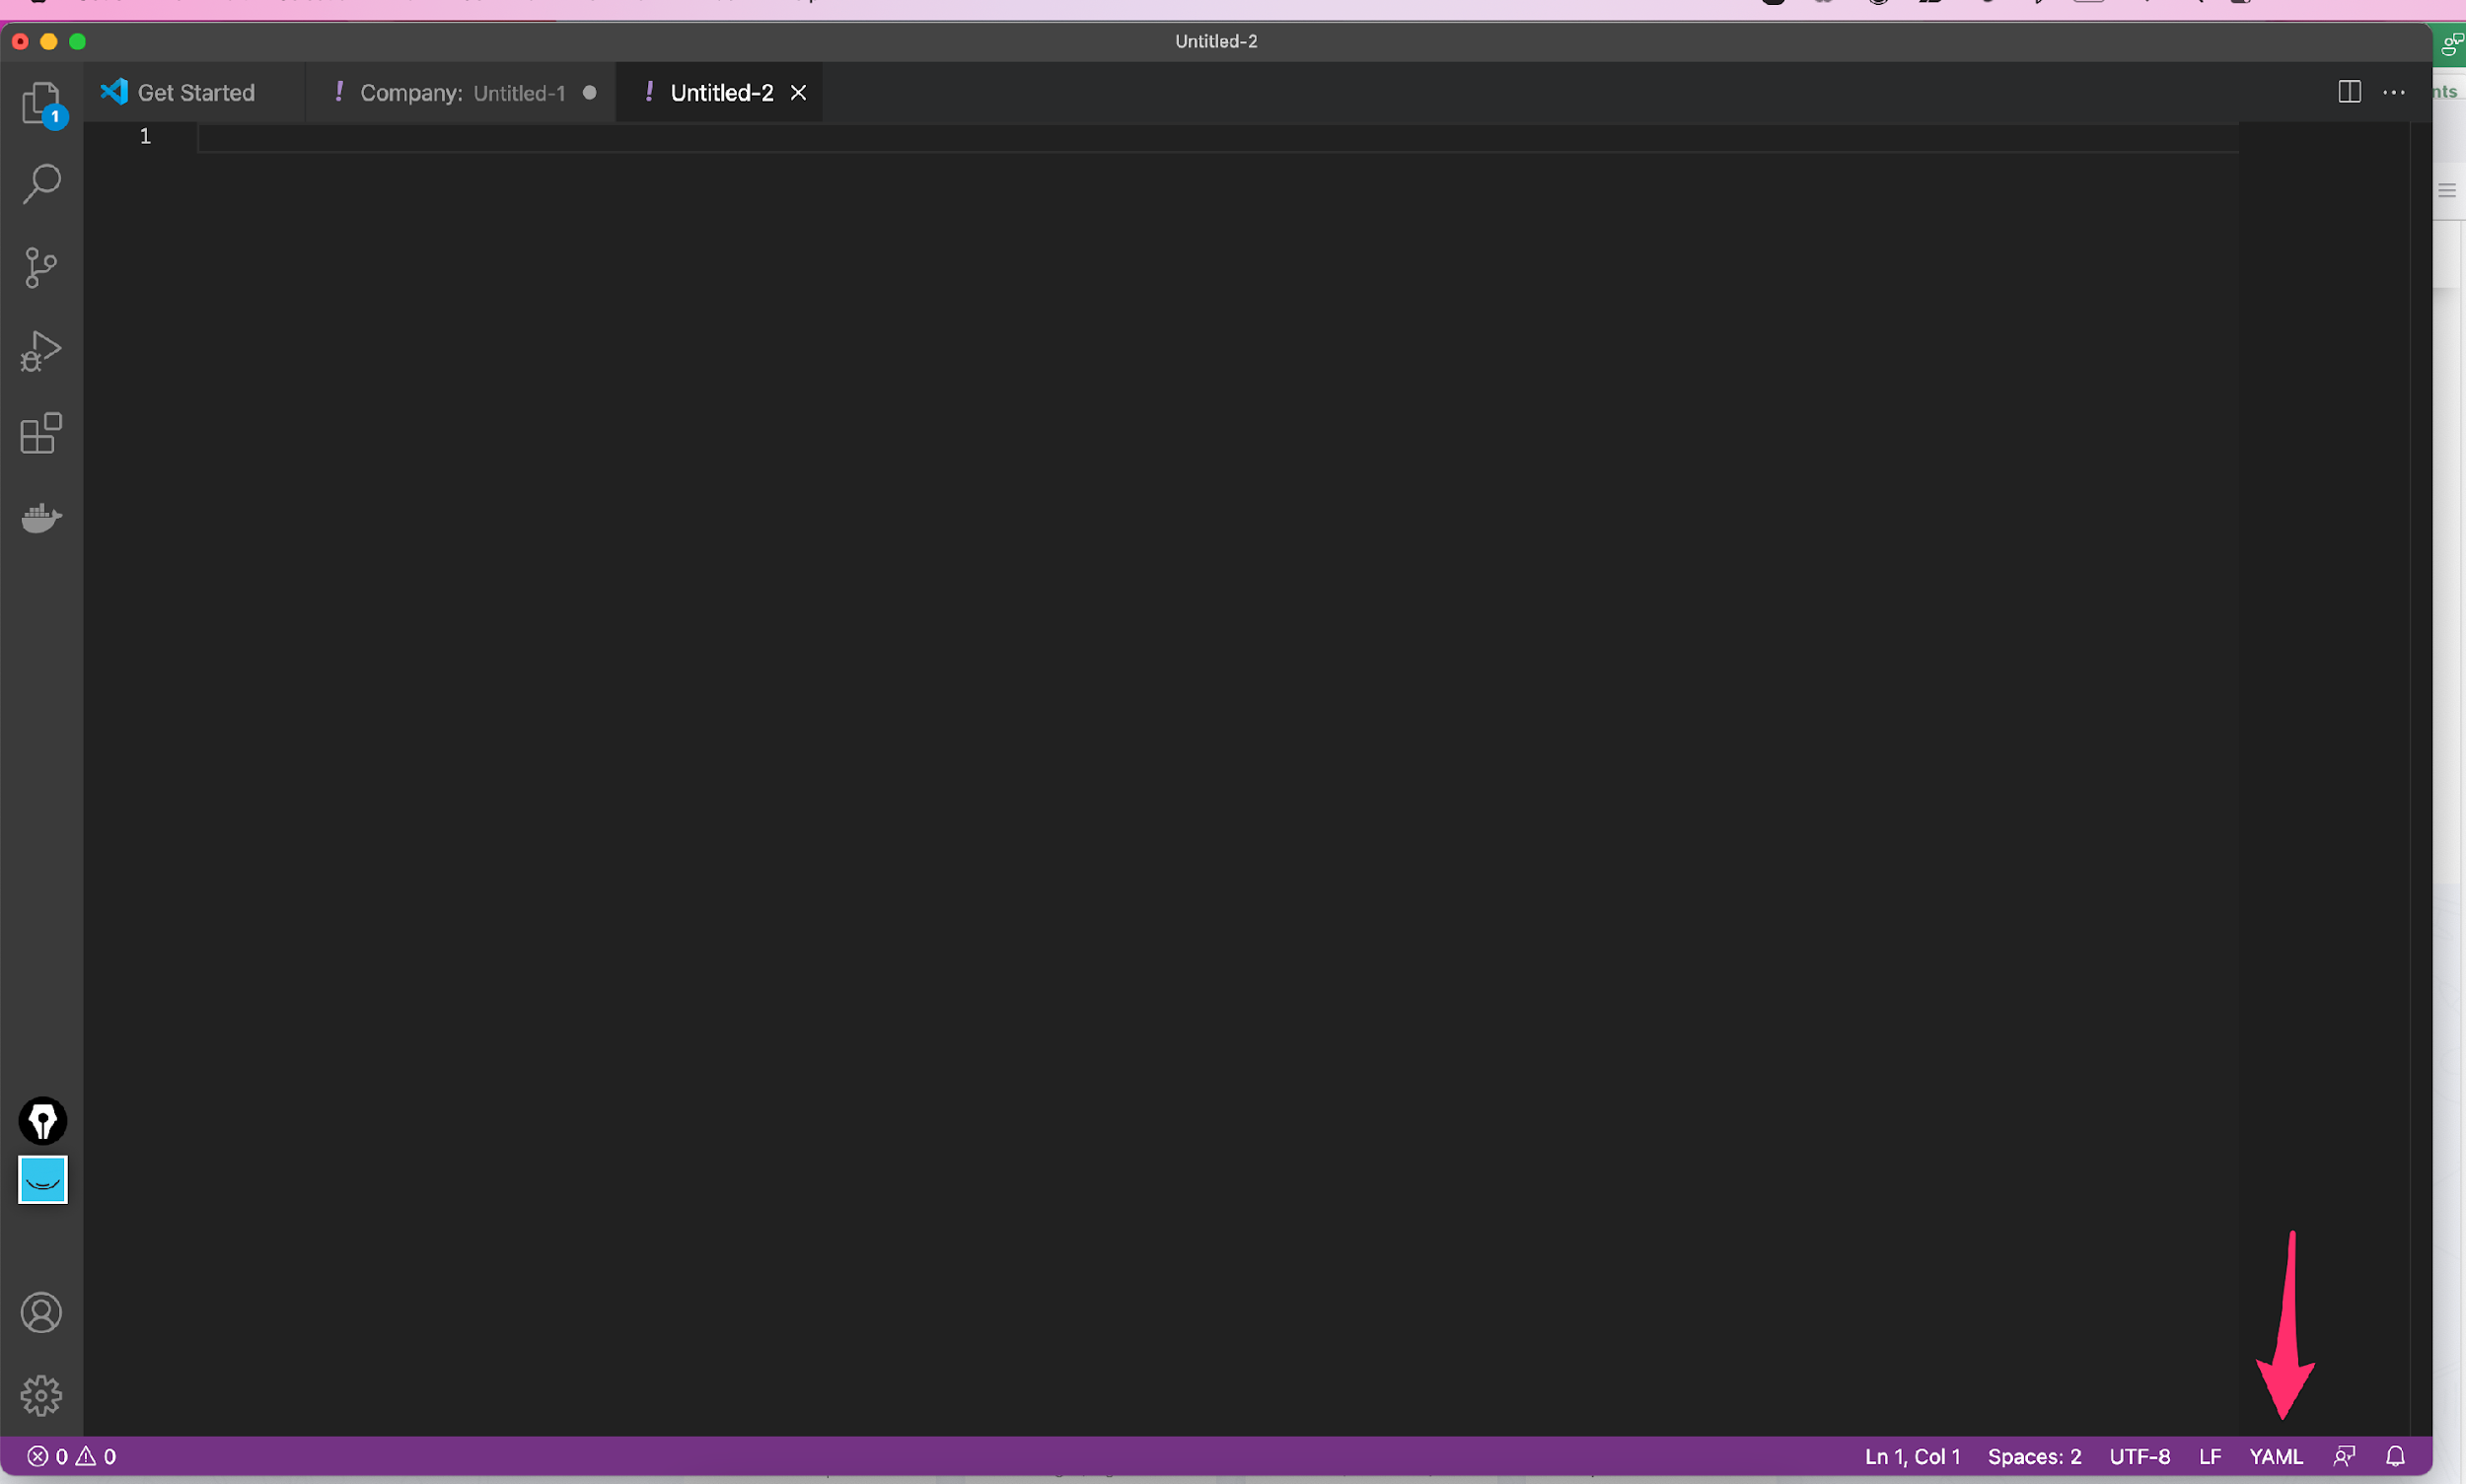
Set vscode to yaml
Check below to make sure your language has been set, it should appear where the arrow is pointing

Slide 10

You will be setting your vscode with the same technique when we will be using the following:
1- Bash script
2- Dockerfile
3- docker-compose
4- jenkinsfile
5- json
6- Kubernetes manifest

Slide 11


Slide 12



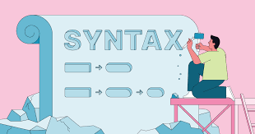

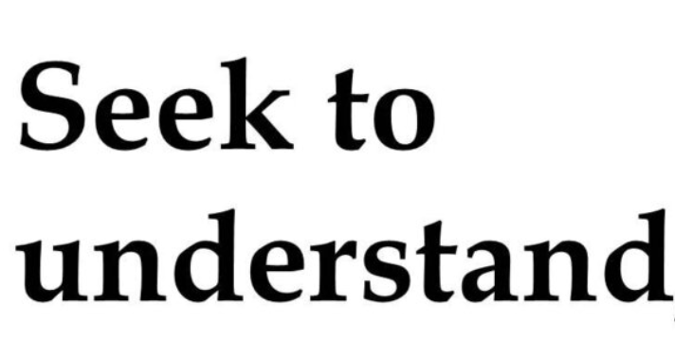


Then if you need write any code in just ask

Slide 13
What is yaml ?
YAML is a human-readable data serialization standard that can be used in conjunction with all programming languages and is often used to write configuration files.
Overview
The recursive YAML acronym stands for “YAML Ain’t Markup Language,” denoting it as flexible and data-oriented.

Slide 14
Where are we going use yaml in this training
Docker-compose
Kubernetes manifest
Helm Chart
Ansible
Gitlab

Slide 15
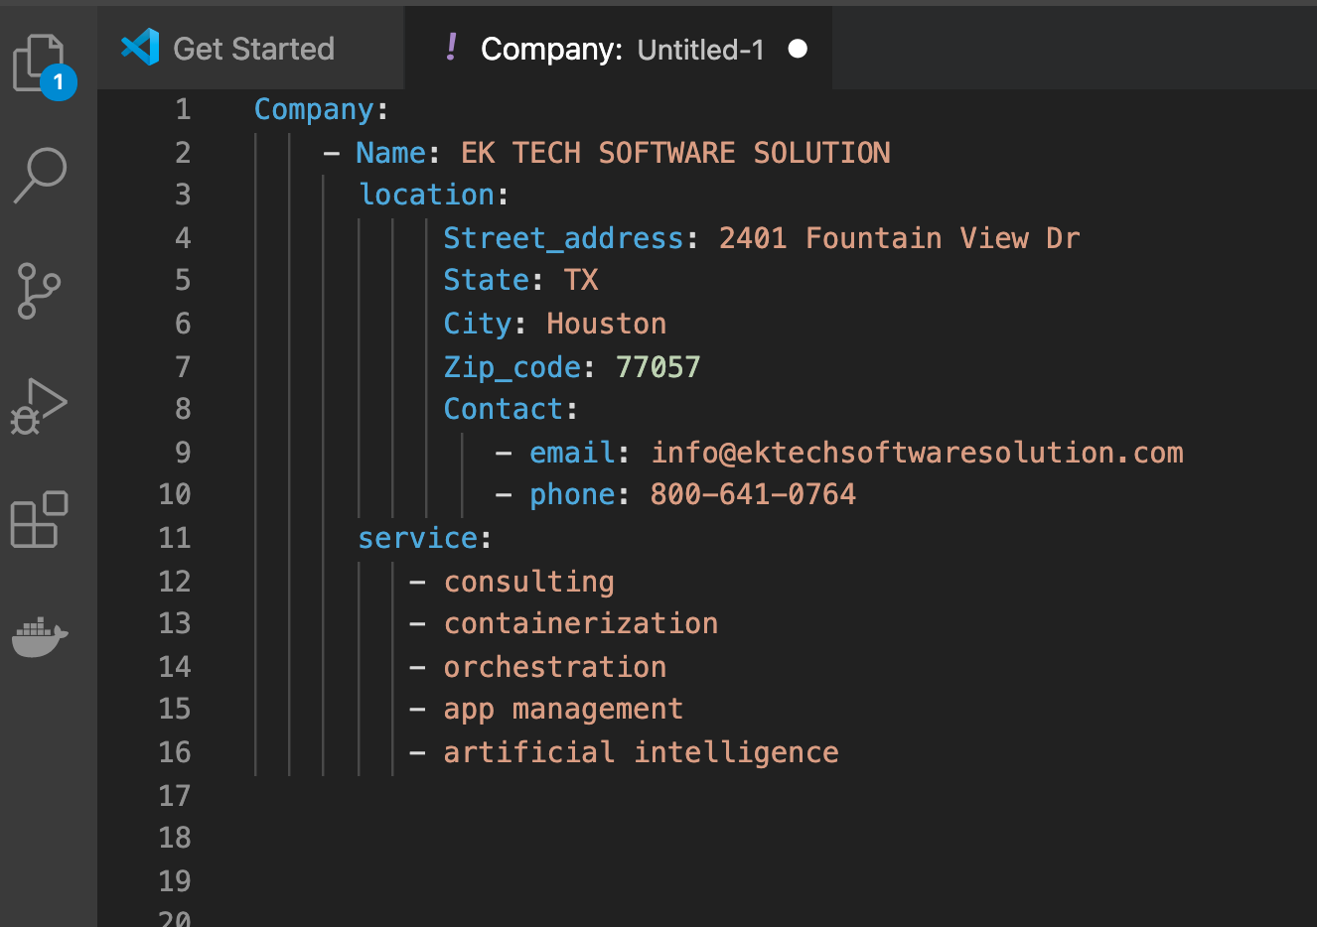
Sample yaml file

Slide 16
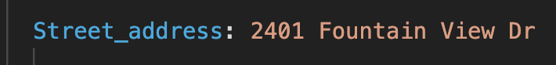
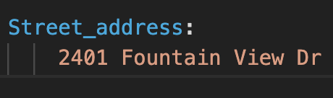

Quick Reminder
Is the same as

Slide 17

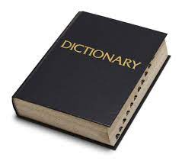

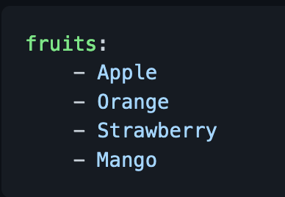
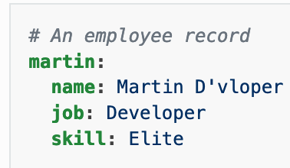
IMPORTANT CONCEPT IN YAML

Slide 18
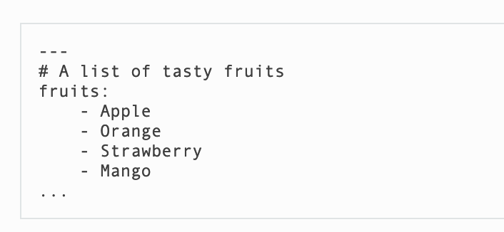

IMPORTANT CONCEPT IN YAML List
All members of a list are lines beginning at the same indentation level starting with a "- " (a dash and a space):

Slide 19
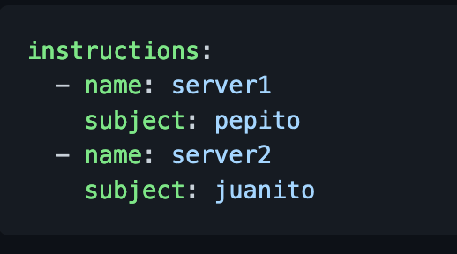
IMPORTANT CONCEPT IN YAML Dictionary
A dictionary is represented in a simple key: value form (the colon must be followed by a space):

Slide 20
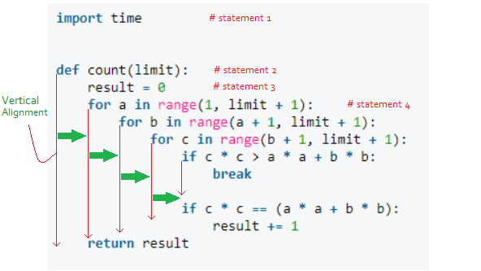
What is important about yaml: Indentation
In YAML block styles, structure is determined by indentation. In general, indentation is defined as a zero or more space characters at the start of a line.
In simple English Indentation are spaces represented by green arrows on the pictures

Slide 21
Identation
Let us pay attention to couple of de details
the string Company is located to the far left and everything is under it. This means that Company is the parent and anything under it are his children.
But as we can see under company we have strings that also have strings under them it means they are parents as well
But let us not lose track
Name
location
Services
Are all located under Company but, if we pay close attention we will find out that they are all line up at the same level
What does it means that they are all at the same level it means that they have same importance under Company
It is just like you children they all have the same importance in front of you

Slide 22
Identation
So Name, location and Service are at the same level therefore have the same importance
But location have couple of stuff under it and they are all line up at the same level
It means that they belong to location only and NOT name and service
They same apply to service as we can see.

Slide 23
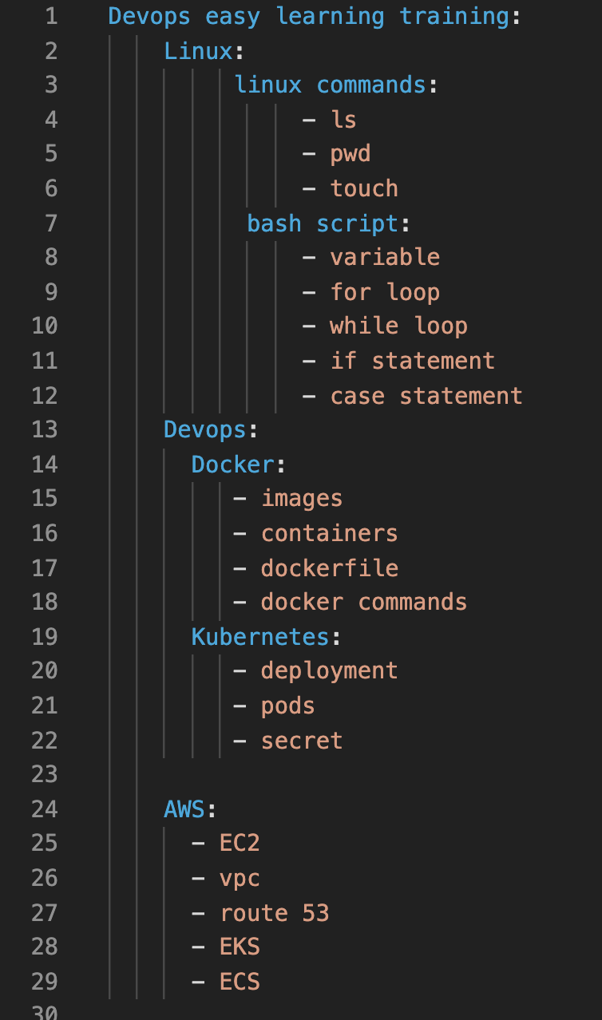
Identation.
Who can Explain this to me ?
NO WORRY, see in class

Slide 24
Father
and
Child
Concept

Slide 25
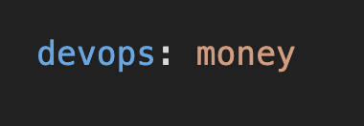

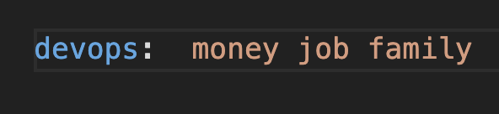

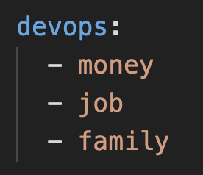

Slide 26

Single child father
devops: money
Father
child
devops:
- money
Father
child

Slide 27
Single child father
devops:
- money
Father
child

Slide 28
multiple children father
devops: money job company security
Father
devops:
- money
- job
- company
- security
children
Father
children

Slide 29



Slide 30
instead of this form when you have multiple children
because this form is not really use out there
devops:
- money
- job
- company
- security
devops: money job company security
use this form when you have multiple children because 99.99% of DevOps engineers use it

Slide 31
WHAT HAPPEN WHEN A FATHER BECOME GRANDFATHER ?

Slide 32
GrandFather
Child
GrandSon
Concept

Slide 33
devops is the parent of money and money is the parent of job
all are defined under devops because devops is the HEAD of the family
devops:
money:
- job
GrandFather
Son
GrandChild

Slide 34

Hey I know you are like it should be of this form below because if money is the child of devops therefore it should also have an - on him
NO NO NO you are very WRONG
devops:
- money:
- job

Slide 35

In YAML when a child gave birth and become a father he cannot be used as a list no more meaning we will not place and - in front of you no more
come on you are a father already and deserve some respect loooooool
devops:
money:
- job
devops:
- money:
- job

Slide 36
GrandFather
Children
with each of them having
Children
Concept

Slide 37
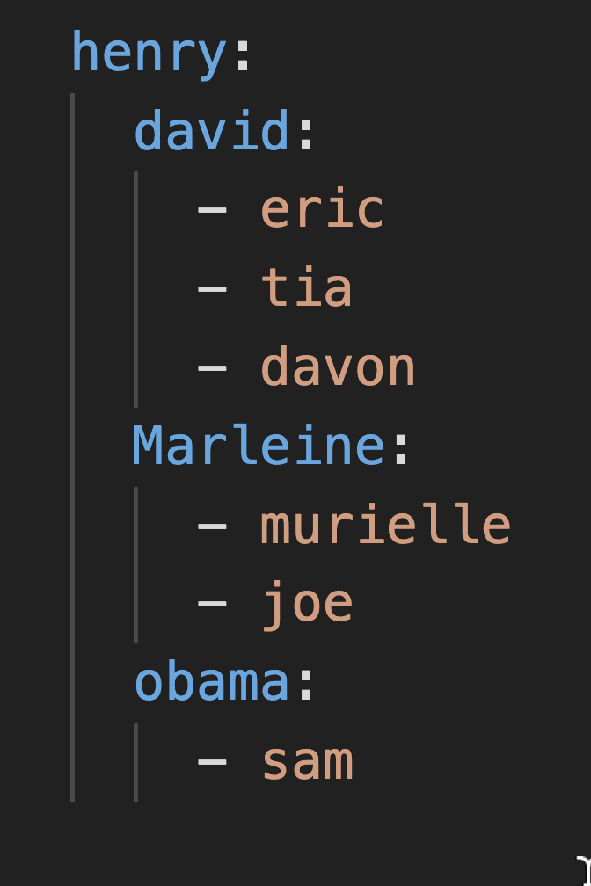
head of family
david children
henry children
pay attention how david,Marleine and obama have the same alignment why because the have the same father and their other of birth here does not matter what matter is the same parent they share together
Marleine children
obama children

